Slide 1
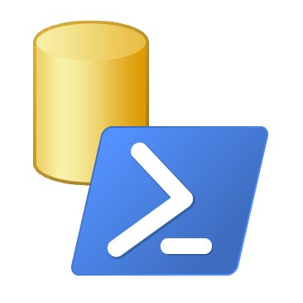
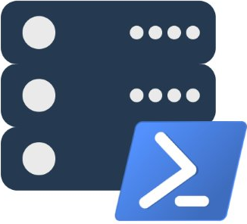
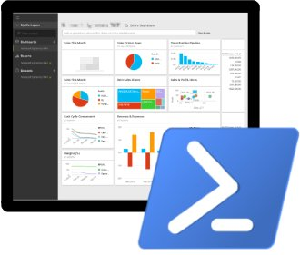
PowerShell ❤ SQL Server Building the Modern DBA’s Toolset
Presented by
Chrissy LeMaire and Rob Sewell

Slide 2
Brief History of SQL Server + PowerShell
SQLSERVER:\>_
dbatools.io | dbareports.io | sqlps.io | sqlps.io/slack | dbatools.io/youtube

Slide 3
First Release - SQL Server 2008
August 2008
Minishell - SQLPS.exe
Snapin - SqlServerProviderSnapin100
5 commands + Provider
Invoke-SqlCmd
Invoke-PolicyEvaluation
Convert-UrnToPath
Encode-SqlName
Decode-SqlName
dbatools.io | dbareports.io | sqlps.io | sqlps.io/slack | dbatools.io/youtube

Slide 4
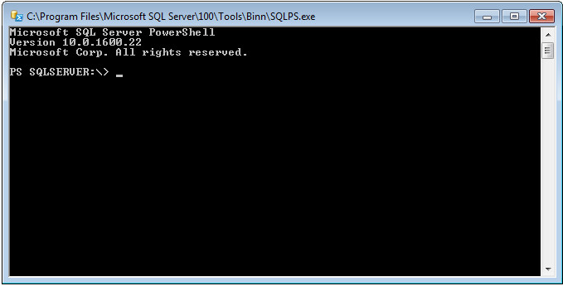
SQLPS.exe
dbatools.io | dbareports.io | sqlps.io | sqlps.io/slack | dbatools.io/youtube
Notes:
Say Thank You to the organisers and the volunteers

Slide 5
Second Release - SQL Server 2012
April 2012
Module called SQLPS
33 total commands (28 new)
22 Availability Group commands
4 SQL Credential commands
2 Backup Restore Commands
New areas in the SQL Server Provider PS SQLSERVER:\> ———– SQL SQLPolicy SQLRegistration DataCollection XEvent Utility DAC IntegrationServices SQLAS
dbatools.io | dbareports.io | sqlps.io | sqlps.io/slack | dbatools.io/youtube
Notes:
44 Months

Slide 6
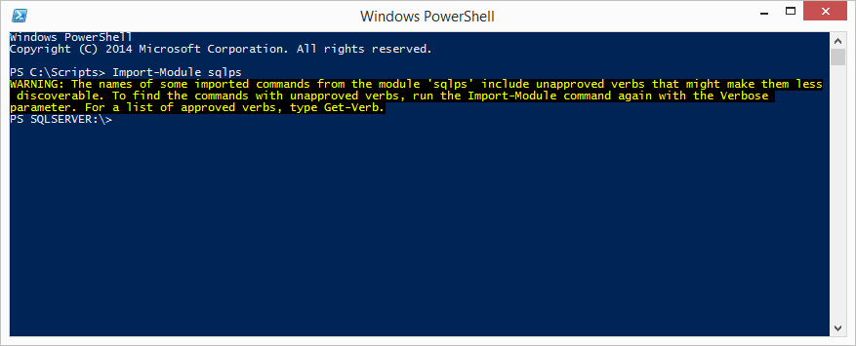
SQLPS Module
dbatools.io | dbareports.io | sqlps.io | sqlps.io/slack | dbatools.io/youtube

Slide 7
Third Release - SQL Server 2014
April 2014
45 total commands (12 new)
Firewall commands
4 Get commands (Database, Instance)
3 Set Commands
Start/Stop SQL instance
dbatools.io | dbareports.io | sqlps.io | sqlps.io/slack | dbatools.io/youtube
Notes:
6 years into it and we’ve only got 45 commands
Add-SqlFirewallRule
Get-SqlCredential
Get-SqlDatabase
Get-SqlInstance
Get-SqlSmartAdmin
Remove-SqlFirewallRule
Set-SqlAuthenticationMode
Set-SqlNetworkConfiguration
Set-SqlSmartAdmin
Start-SqlInstance
Stop-SqlInstance
Test-SqlSmartAdmin

Slide 8
SQLPS Module
dbatools.io | dbareports.io | sqlps.io | sqlps.io/slack | dbatools.io/youtube

Slide 9
Issues persisted
Tab-completion didn’t work
Invoke-SqlCmd was buggy
-WhatIf actually performed commands
SQLPS was slow to load
SQLPS changed the directory unexpectedly
SQLPS used unapproved verbs
Other platforms offered 700+ cmdlets
dbatools.io | dbareports.io | sqlps.io | sqlps.io/slack | dbatools.io/youtube
Notes:
We were still stuck at 45

Slide 10







The SQL Community wasn’t happy
dbatools.io | dbareports.io | sqlps.io | sqlps.io/slack | dbatools.io/youtube
Notes:
Responses ranged from sad to resigned to pissed.
Felt Microsoft was unresponsive. Commands were random and few. No basic commands. Bugs were never/rarely fixed.

Slide 11

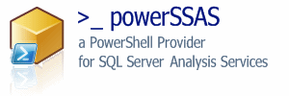


Community Response
PowerSSAS - 2007
SQLPSX - 2008
Get-SqlServer
Get-SqlDatabase
Get-SqlLogin
Get-SqlServerRole
75+ additional commands
SSRS PowerShell Provider - 2009
SPADE - 2011
Automated Installation Engine
dbatools - 2015
Migrations & Best Practices
dbareports - 2016
Reporting
dbatools.io | dbareports.io | sqlps.io | sqlps.io/slack | dbatools.io/youtube
Notes:
But these were still just filling in some of the gaps that were left by Microsoft that dbas and dbas and developers needed

Slide 12



2016 has been an amazing year!
dbatools.io | dbareports.io | sqlps.io | sqlps.io/slack | dbatools.io/youtube
Notes:
2016 changed everything

Slide 13
Everything’s changed
The SQL Server team hired a dedicated PowerShell engineer
Microsoft began taking Connect Items (suggestions + bug reports) seriously
SQLPS was renamed to SqlServer
Made it easier to do REGULAR RELEASES!
Initially these were monthly releases
But then they were doing two a month of SSMS
Working to separate from SSMS and go straight to the PowerShell Gallery
dbatools.io | dbareports.io | sqlps.io | sqlps.io/slack | dbatools.io/youtube

Slide 14
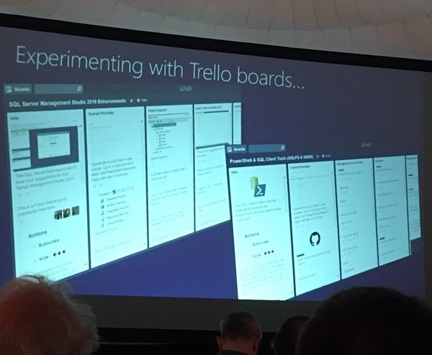
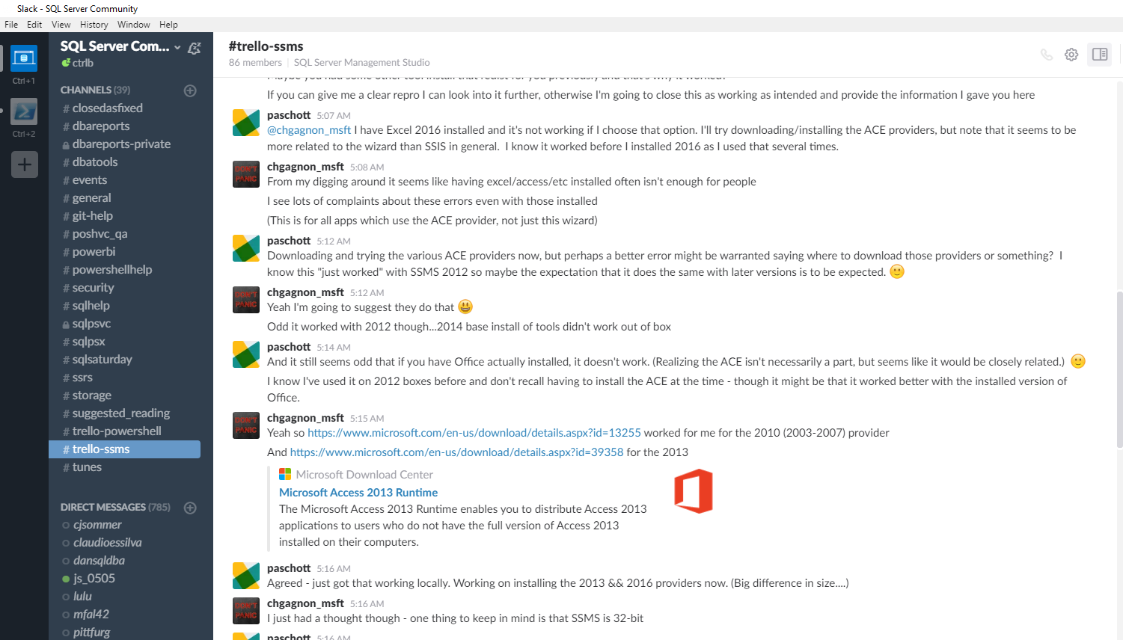
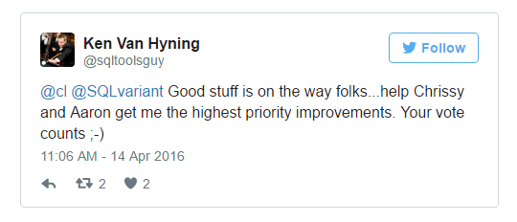
SQL Client Tools Renaissance
The SQL Server team began directly interacting with the community
SQL Community Trello boards - sqlps.io/vote & sqlps.io/ssms
SQL Community Slack - sqlps.io/slack
Twitter
The highest voted commands were created! Most talked about issues, fixed.
dbatools.io | dbareports.io | sqlps.io | sqlps.io/slack | dbatools.io/youtube
Notes:
Now the SQL team actually leads in community interaction, and other platform communities are asking their own Microsoft product group to use the SQL Server team’s approach as a model

Slide 15

SQL Client Tools Renaissance
“A few years back the SQL organization needed many of the engineers in the team to go help on Azure SQL Database. This included many of us from the tools team which had obvious impact on our ability to do anything significant in the SQL Client Tools space as a whole. We have been reinvesting in the tools again and I get a chance to be a part of leading our SQL Client Tools Renaissance we have begun.”
Ken Van Hyning, Engineering Manager for SQL Server Client Tools and All-Around Hero
dbatools.io | dbareports.io | sqlps.io | sqlps.io/slack | dbatools.io/youtube
Notes:
Microsoft also became more open in communicating the issues
Ken explained that engineers were poached, and the SQL Tools were neglected

Slide 16
25 New Cmdlets + 3 Fixes + New Name
New Name!
Import-Module SqlServer
Always Encrypted
Add-SqlAzureAuthenticationContext
Add-SqlColumnEncryptionKeyValue
Complete-SqlColumnMasterKeyRotation
Get-SqlColumnEncryptionKey
Get-SqlColumnMasterKey
Invoke-SqlColumnMasterKeyRotation
New-SqlAzureKeyVaultColumnMasterKeySettings
New-SqlCngColumnMasterKeySettings
New-SqlColumnEncryptionKey
New-SqlColumnEncryptionKeyEncryptedValue
New-SqlColumnEncryptionSettings
New-SqlColumnMasterKey
New-SqlCspColumnMasterKeySettings
Remove-SqlColumnEncryptionKey
Remove-SqlColumnEncryptionKeyValue
Remove-SqlColumnMasterKey
Set-SqlColumnEncryption
SQL Server Agent
Get-SqlAgent
Get-SqlAgentJob
Get-SqlAgentJobHistory
Get-SqlAgentJobSchedule
Get-SqlAgentJobStep
Get-SqlAgentSchedule
Error Log
Get-SqlErrorLog
Set-SqlErrorLog
Invoke-Sqlcmd
-ConnectionString Parameter
-OutputAs (As) Parameter
Provider
WhatIf and Confirm now fully supported
dbatools.io | dbareports.io | sqlps.io | sqlps.io/slack | dbatools.io/youtube
Notes:
Company directive on the right
Are being created
We have a total of 75 cmdlets, up from 45, and more being released regularly

Slide 17
dbatools ❤ SQL Server
Presented by
Chrissy LeMaire, MVP
chrissy lemaire, mvp: netnerds.net, @cl code: dbatools.io

Slide 18
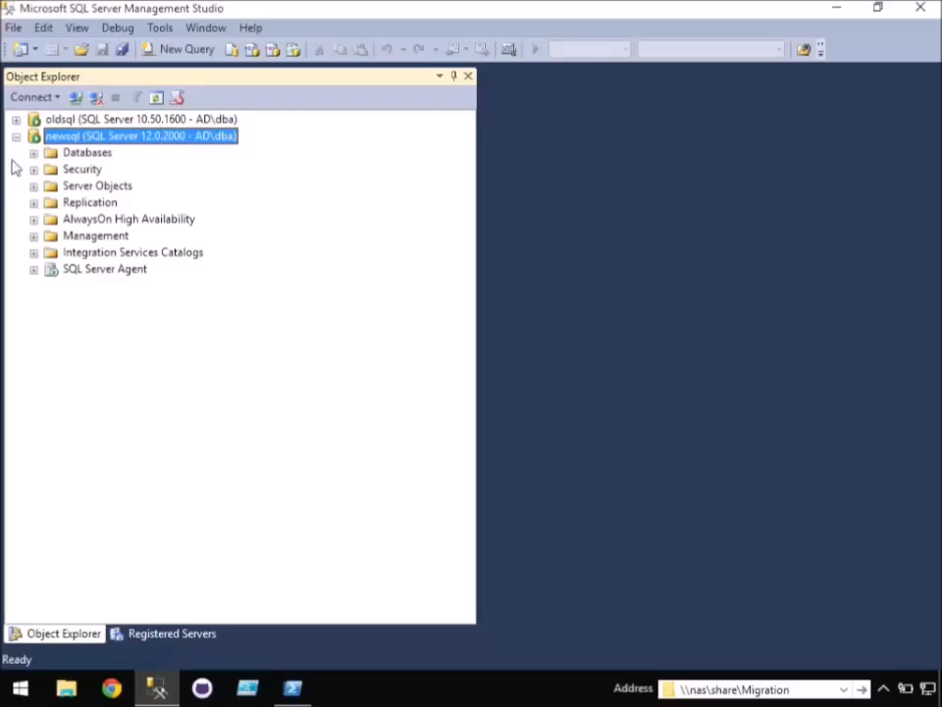
-WhatIf SQL Server Migrations went more like this…
dbatools.io | dbareports.io | sqlps.io | sqlps.io/slack | dbatools.io/youtube

Slide 19

Cloud & DataCenter (PowerShell)
2015, 2016, 207
chrissy lemaire, mvp: netnerds.net, @cl code: dbatools.io

Slide 20

DBA at NATO Special Ops
chrissy lemaire, mvp: netnerds.net, @cl code: dbatools.io

Slide 21

twitter
@cl
chrissy lemaire, mvp: netnerds.net, @cl code: dbatools.io
Notes:
Community project, initially started out as Start-SqlMigration but has grown into a DBA’s best friend. dbatools currently sports 79 commands.
How many of you have heard of dbatools? How many of you have used it? How many knew it was born in Belgium? :D

Slide 22
Agenda - dbatools
Who
Requirements
Hella Demos
1
2
3
4
5
6
Overview
Install
Questions!
dbatools.io | dbareports.io | sqlps.io | sqlps.io/slack | dbatools.io/youtube

Slide 23




whoami
Chrissy LeMaire, Microsoft PowerShell MVP
Sr. Systems Engineer/DBA for General Dynamics IT at NATO Special Ops HQ in Belgium
SQL Server since 1999 and PowerShell since 2005
Email: clemaire@gmail.com
Profile:
Chrissy LeMaire
@cl
Tech:
netnerds.net, dbatools.io
Food:
RealCajunRecipes.com
dbatools.io | dbareports.io | sqlps.io | sqlps.io/slack | dbatools.io/youtube

Slide 24

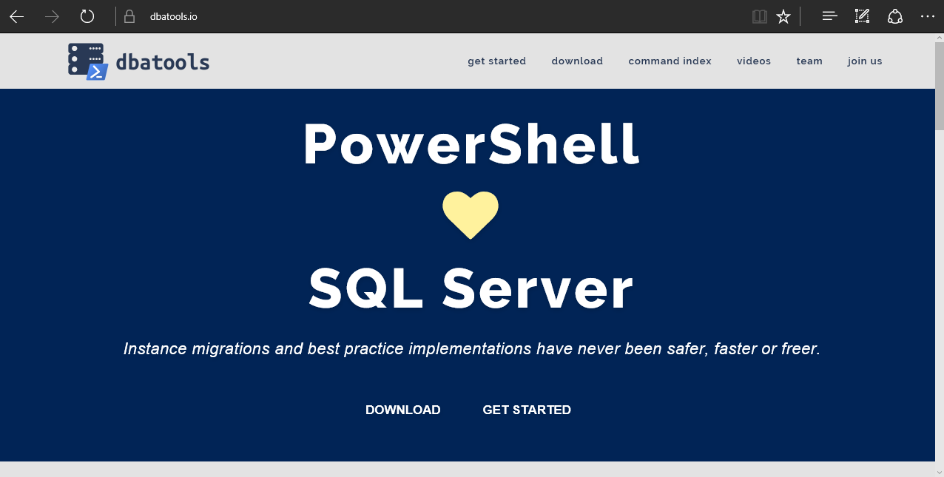
dbatools
dbatools.io | dbareports.io | sqlps.io | sqlps.io/slack | dbatools.io/youtube
Notes:
Community project, initially started out as Start-SqlMigration but has grown into a DBA’s best friend. dbatools currently sports 100 commands.
How many of you have heard of dbatools? How many of you have used it?

Slide 25
System Requirements
Minimum
Client
PowerShell v3
SQL Server Management Studio 2008 R2
Server
SQL Server 2000
Recommended
Client
PowerShell v5
SQL Server Management Studio 2012+
Server
SQL Server 2005+
dbatools.io | dbareports.io | sqlps.io | sqlps.io/slack | dbatools.io/youtube
Notes:
Started as a migration tool, so I strived to support older environments
No reliance on SQLPS, because we’ve got a history ;)

Slide 26
Install is easy
PowerShell Gallery
Install-Module dbatools
Install-Module dbatools –Scope CurrentUser
GitHub – dbatools.io/git
Invoke-Expression (Invoke-WebRequest https://dbatools.io/in)
Clone repo found at dbatools.io/git, Import-Module dbatools
dbatools.io | dbareports.io | sqlps.io | sqlps.io/slack | dbatools.io/youtube
Notes:
Gallery requires admin access and is built into PowerShell v5. Other versions also support it with a bit of configuration.
Download
Unzip
Import-Module

Slide 27
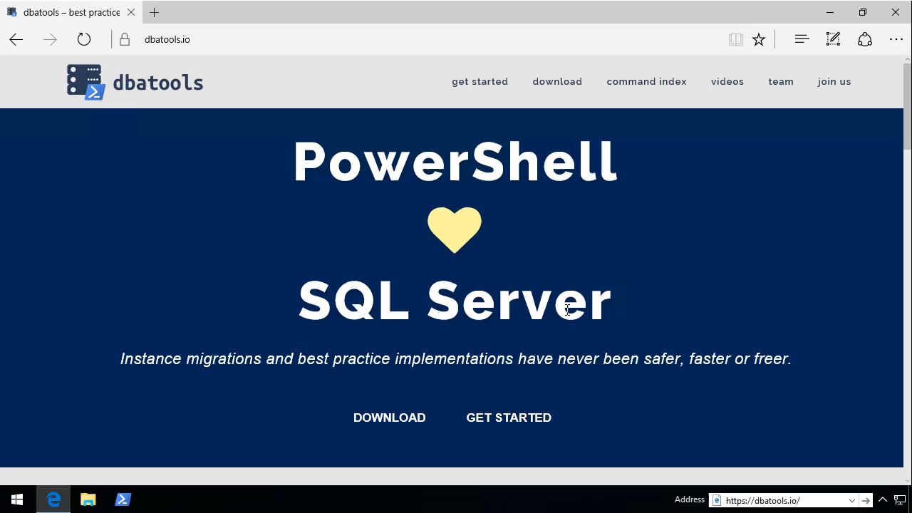
See?
dbatools.io | dbareports.io | sqlps.io | sqlps.io/slack | dbatools.io/youtube

Slide 28
Support
SQL Server 2000 – vNext
Express – Datacenter Edition
Clustered and stand-alone instances
Windows and SQL authentication
Default and named instances
Multiple instances on one server
Auto-populated parameters for command-line completion (think -Databases and -Logins)
dbatools.io | dbareports.io | sqlps.io | sqlps.io/slack | dbatools.io/youtube

Slide 29
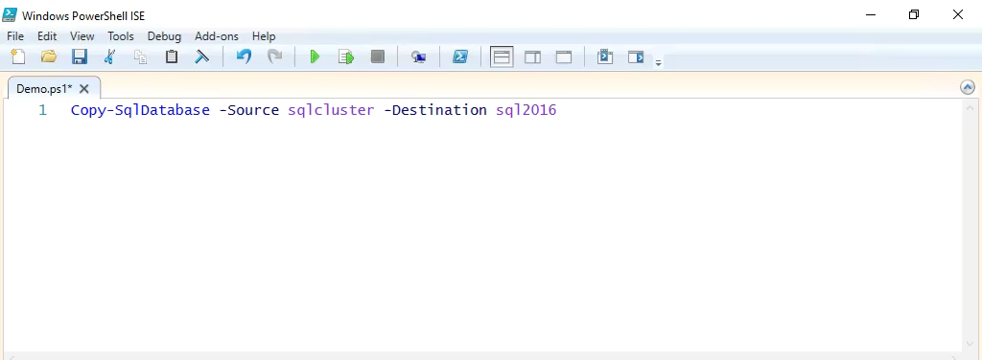
Support
dbatools.io | dbareports.io | sqlps.io | sqlps.io/slack | dbatools.io/youtube

Slide 30
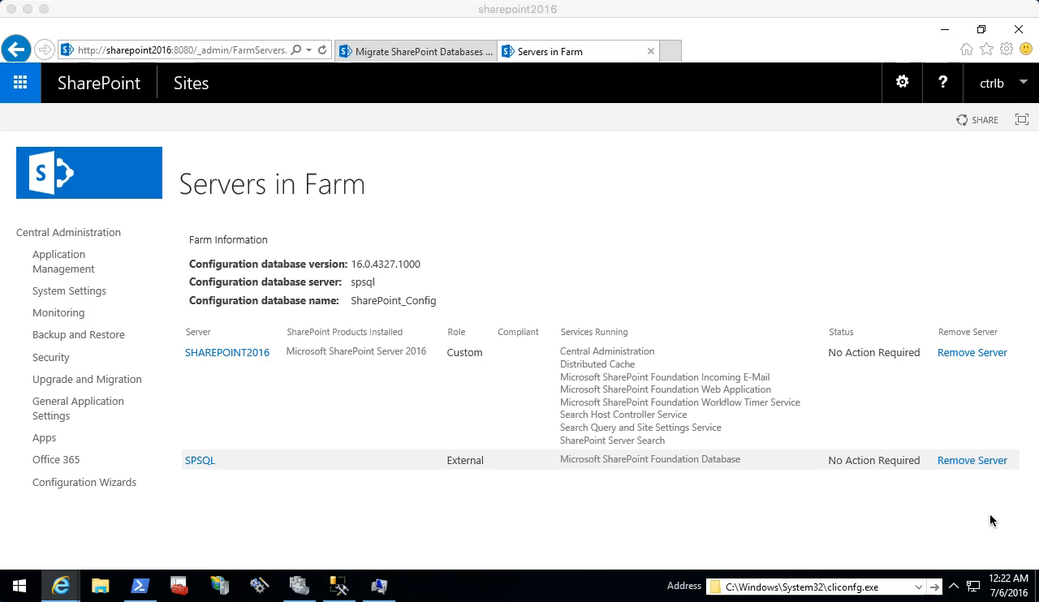
Start-SqlMigration
dbatools.io | dbareports.io | sqlps.io | sqlps.io/slack | dbatools.io/youtube

Slide 31

Start-SqlMigration
dbatools.io | dbareports.io | sqlps.io | sqlps.io/slack | dbatools.io/youtube

Slide 32
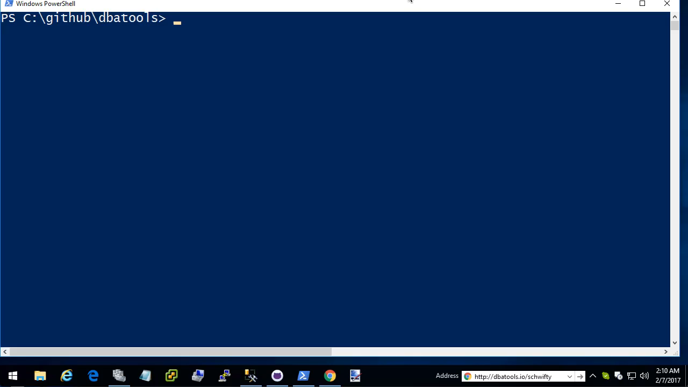
Test-DbaSpn
dbatools.io | dbareports.io | sqlps.io | sqlps.io/slack | dbatools.io/youtube

Slide 33
SQL Server Administration and Best Practices
demo
dbatools.io | dbareports.io | sqlps.io | sqlps.io/slack | dbatools.io/youtube

Slide 34


dbareports.io
Rob Sewell
dbatools.io | dbareports.io | sqlps.io | sqlps.io/slack | dbatools.io/youtube

Slide 35
whoami
Rob Sewell
PowerShell, Azure, Automation and SQL (PaaS Geddit ? ☺ )
Email: mrrobsewell@outlook.com
Profile:
Rob Sewell
@sqldbawithbeard
Tech:
sqldbawithabeard.com dbareports.io
dbatools.io | dbareports.io | sqlps.io | sqlps.io/slack | dbatools.io/youtube

Slide 36
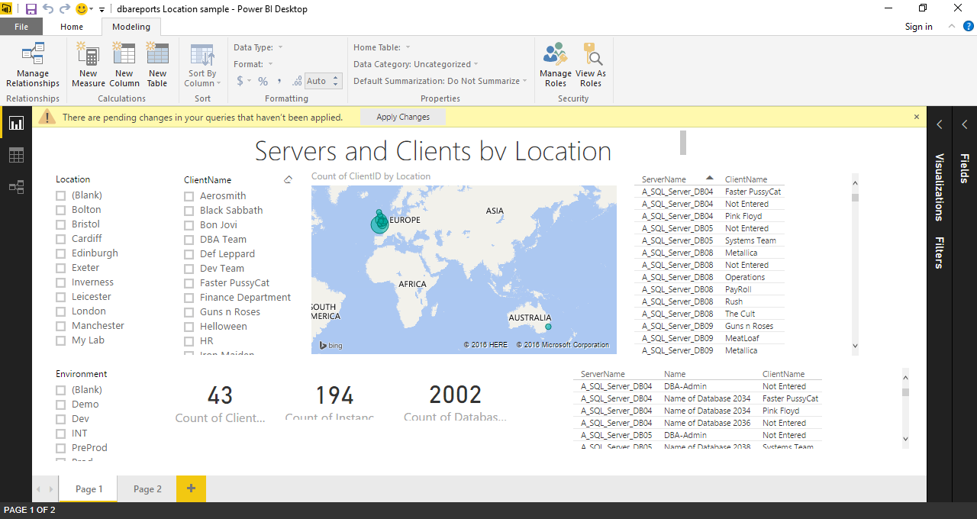
dbareports.io
dbatools.io | dbareports.io | sqlps.io | sqlps.io/slack | dbatools.io/youtube

Slide 37
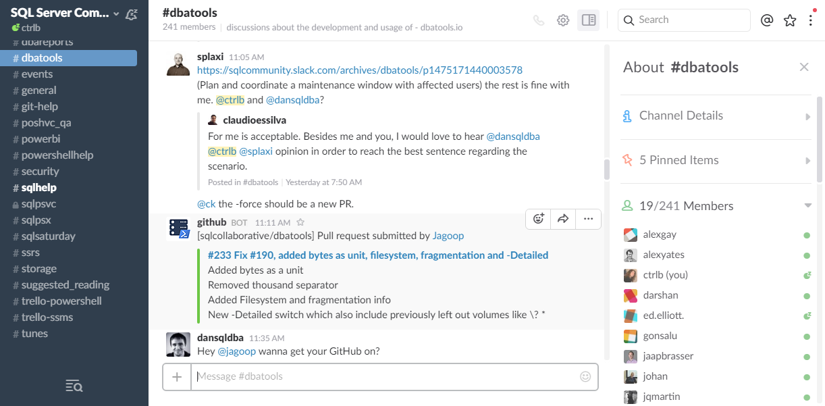
Join us! - dbatools.io/slack
dbatools.io | dbareports.io | sqlps.io | sqlps.io/slack | dbatools.io/youtube

Slide 38
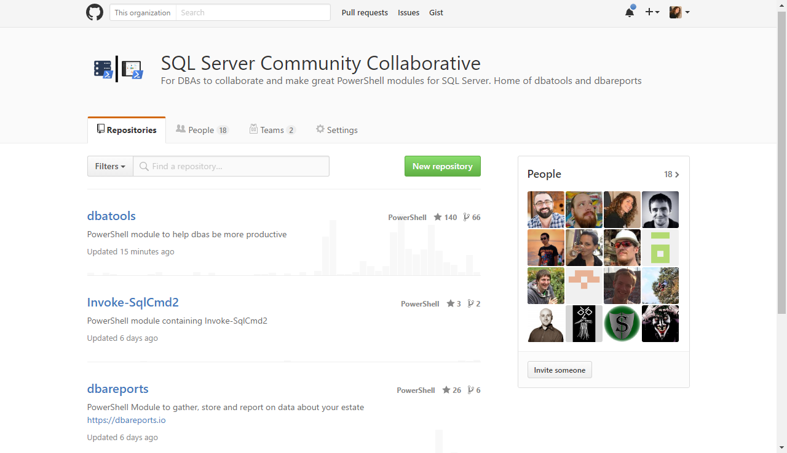
Join us! – github.com/sqlcollaboratve
dbatools.io | dbareports.io | sqlps.io | sqlps.io/slack | dbatools.io/youtube

Slide 39

Community got us feelin’ like
dbatools.io | dbareports.io | sqlps.io | sqlps.io/slack | dbatools.io/youtube
Notes:
Cut it out.

Slide 40
Review
PowerShell is a DBA’s best friend Migrations Best Practices Reporting
Join us! dbatools.io/slack #dbatools #dbareports
dbatools.io | dbareports.io | sqlps.io | sqlps.io/slack | dbatools.io/youtube

Slide 41
How to Get-Help
Extensive documentation within each command Get-Help Start-SqlMigration –Detailed
Extensive documentation on dbatools.io
dbatools.io/Start-SqlMigration
dbatools.io/Repair-SqlOrphanUser
Some commands have videos
dbatools.io/youtube
dbatools.io | dbareports.io | sqlps.io | sqlps.io/slack | dbatools.io/youtube

Slide 42


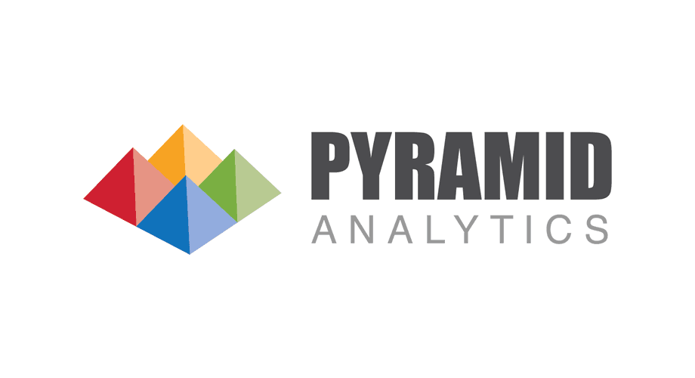


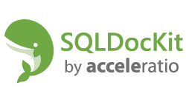







Our Sponsors
Notes:
If you think, that a SQL Saturday is a nice possibility to learn from and network with fellow SQL Server enthusiasts FOR FREE,
I just ask you one thing: Visit the sponsor booths and chat with the sponsors!
They are covering the expenses for each and every of you, with is around EUR 60 …

